Slide 1
Computational terminography: extracting knowledge from texts
Špela Vintar
Dept. of Translation Studies
University of Ljubljana
Terminology Symposium Zadar, 22-23 August 2014

Slide 2
Overview
Why computational terminography?
From unstructured data to knowledge
Term extraction
statistical vs. linguistic approaches
bilingual term extraction
Definition extraction
Applications, perspectives, problems
Conclusion
Terminology Symposium Zadar, 22-23 August 2014

Slide 3
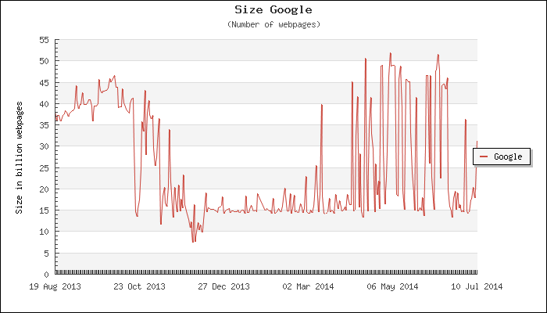
Why computational terminography?
Information society produces a lot of data…
Estimated size of Google’s index: 14 billion web pages
Average daily information load: 34 GB (incl. 100,000 words of text)
A large portion of this information is specialized:
Containing domain-specific knowledge, encoded in specialized vocabulary
Understood by the targeted community of experts
Main obstacle in transferring specialized knowledge is translating terminology
Terminology Symposium Zadar, 22-23 August 2014

Slide 4
Why computational terminography?
Translators = second largest community of terminology users
Greatest challenges:
Instant access to appropriate terminology in the target language
Domain-, client-, project-, genre- and text-specific !
Not provided by traditional resources.
Reuse of term resources
Glossary of terms vs. knowledge map
CT = a response to this challenge by exploiting corpora and providing NLP tools
Terminology Symposium Zadar, 22-23 August 2014

Slide 5
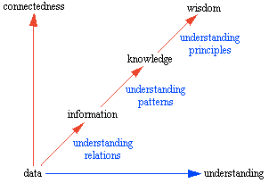
From unstructured data to knowledge
Most of human knowledge is contained in texts -> unstructured because knowledge particles are not explicitly marked.
For fast access to knowledge we need to extract concepts and relations between them:
NLP techniques such as term & definition extraction, aka Text Mining & Knowledge Extraction.
Knowledge structures can be used in:
(Machine) Translation
Question Answering
Automatic Document Indexing & Classification
Building user- and context-aware applications
…
Source: Ackoff, R. L., "From Data to Wisdom",
Journal of Applied Systems Analysis, Volume 16, 1989 p 3-9.
Terminology Symposium Zadar, 22-23 August 2014

Slide 6
Through-feed centreless grinding is characterised by its complexity, non-linearity and sensibility to a large number of factors that influence process stability and grinding precision. In conventional regulating wheel dressing, a single-point diamond tool is usually traversed across the regulating wheel in a straight line. In resulting regulating wheel geometry the contact between the regulating wheel and the workpiece along the traverse axis is interfered. This interference problem is a significant source of process instability and workpiece out-of-roundness. [...]
Terminology Symposium Zadar, 22-23 August 2014

Slide 7
Through-feed centreless grinding is characterised by its complexity, non-linearity and sensibility to a large number of factors that influence process stability and grinding precision. In conventional regulating wheel dressing, a single-point diamond tool is usually traversed across the regulating wheel in a straight line. In resulting regulating wheel geometry the contact between the regulating wheel and the workpiece along the traverse axis is interfered. This interference problem is a significant source of process instability and workpiece out-of-roundness. [...]
improves
modifies
part_of
disrupts
Terminology Symposium Zadar, 22-23 August 2014

Slide 8
abrasive process of removing material from the workpiece by feeding it entirely through the grinding wheels
Through-feed centreless grinding is characterised by its complexity, non-linearity and sensibility to a large number of factors that influence process stability and grinding precision. In conventional regulating wheel dressing, a single-point diamond tool is usually traversed across the regulating wheel in a straight line. In resulting regulating wheel geometry the contact between the regulating wheel and the workpiece along the traverse axis is interfered. This interference problem is a significant source of process instability and workpiece out-of-roundness. [...]
improves
modifies
part_of
disrupts
Terminology Symposium Zadar, 22-23 August 2014

Slide 9
Representing the domain
Ontology (Information Science): formal hierarchical representation of knowledge within a domain including concepts, properties and interrelationships between them.
Termbase: database containing concept-oriented entries of terms, possibly in several languages, and related information such as definitions, usage notes, related concepts etc.
To extract a domain representation from text we need to extract terms (as designations of concepts), definitions of concepts and relations between them (both hierarchical and other), and - in a multilingual setting - find cross-language equivalences.
Terminology Symposium Zadar, 22-23 August 2014

Slide 10
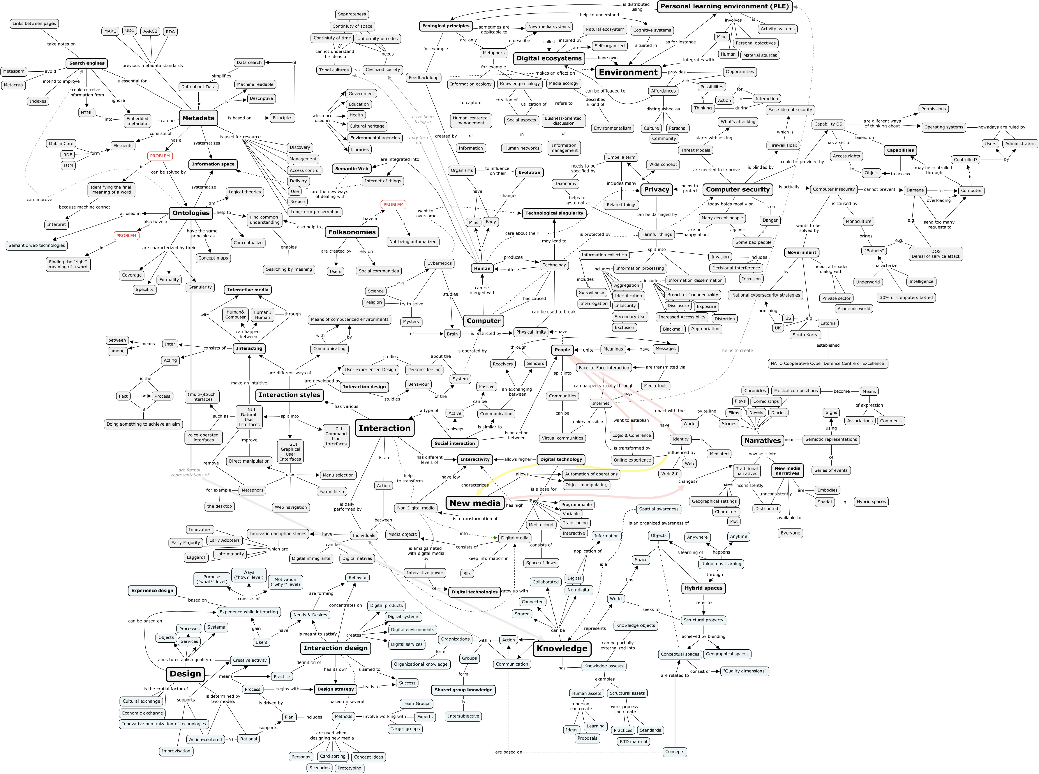

Slide 11
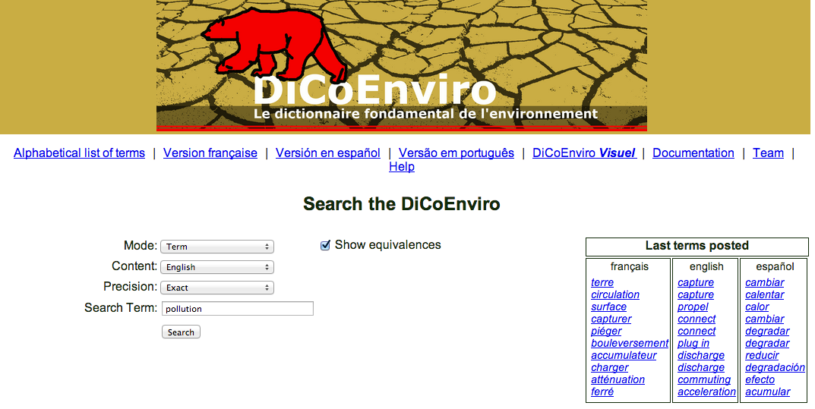
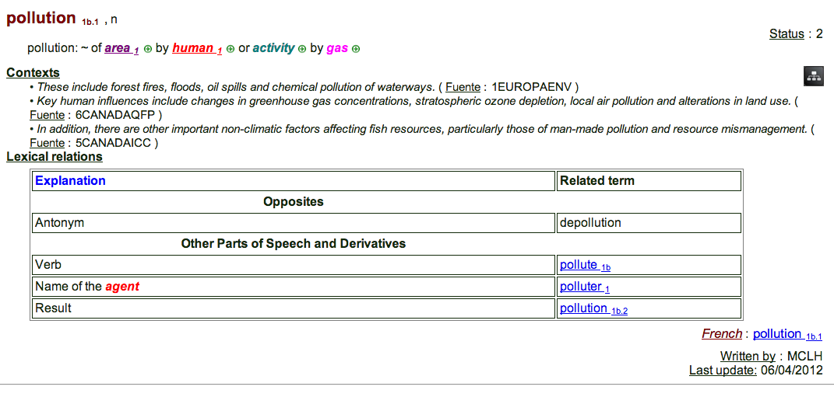

Slide 12
Rules or probabilities? The core dilemma of NLP
Rule-based approaches
cost- and labour intensive
language specific
bad at handling exceptions
require theoretical foundations
slow to adapt for new languages or domains
Statistical approaches
require a lot of data
bad at handling rare phenomena
induced rules may be hard to interpret
hard to correct single errors
Terminology Symposium Zadar, 22-23 August 2014

Slide 13
Statistical approaches to term extraction
“There is no formal distinction between words and terms”. So how do we define them in statistical terms?
Unithood: measuring the syntagmatic strength of multi-word associations
Dagan & Church 1994; Daille 1994; Frantzi et al. 2000
Termhood: measuring the degree of specificity within a particular domain
Sparck Jones 1972: tf.idf; Scott 1997: keywordness; Kilgarriff et al. 2004
Supervised statistical approach: providing training set of terms and non-terms
Nazar 2011
Terminology Symposium Zadar, 22-23 August 2014

Slide 14
Linguistically-informed approaches to term extraction
morphosyntactic patterns: defining sequences of tags that are likely terminological
Justeson & Katz 1995; Bourigault 1996; Jacquemin 2001; Patry & Langlais 2005
hybrid: combining patterns, domain relevance + employing various filters
Vivaldi & Rodriguez 2006; Vintar 2010; Sclano & Velardi 2007
evaluation of TE: precision vs. recall; F-measure
difficult to compare different systems: different datasets, different criteria & methods for measuring precision and recall
recent study by Nazar (2011) reports 75% precision at 80% recall (English, medical domain), thus outperforming Yahoo, Termfinder, Termostat and Termine
Terminology Symposium Zadar, 22-23 August 2014

Slide 15
Multilingual term extraction
combination of monolingual TE + term alignment
using parallel corpora: Ahrenberg et al. 1998; Kwong et al. 2004 (P = 79%); Gaussier (1998): graph-based flow network model (P = 90%)
using comparable corpora: Mann & Yarowsky (2001): cognates; Gaussier et al. (2004):LSA
using both: Vintar 2010: bag-of-equivalents (avP = 83%)
Terminology Symposium Zadar, 22-23 August 2014

Slide 16
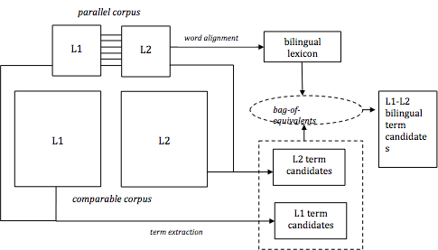
Bilingual TE: LUIZ architecture
Terminology Symposium Zadar, 22-23 August 2014

Slide 17
Definition extraction
What is a definition?
Aristotle: “per genus et differentia”: DEFINIENDUM [Karst] + DEFINITOR [usually refers to] + GENUS [a landscape] + DIFFERENTIA [underlain by limestone which has been eroded by dissolution, producing ridges, towers, fissures, caves and other characteristic landforms].
Most approaches rely on patterns attempting to model this form: Klavans & Muresan 2001; Gaudio & Branco 2007; Westerhout 2009; innovative and more robust approach by Navigli & Velardi 2010: learning word-class lattices.
Fišer, Pollak & Vintar 2010: Combining Machine Learning, TE, patterns and WordNet.
Terminology Symposium Zadar, 22-23 August 2014

Slide 18
Experimental design
Train a classifier on Slovene Wikipedia
Extract definition candidates from a corpus of Slovene popular-scientific texts using three approaches:
WordNet
Term Extraction
Lexicogrammatical patterns
Terminology Symposium Zadar, 22-23 August 2014

Slide 19
Learning rules from Wikipedia
title
definition
non-definition
Terminology Symposium Zadar, 22-23 August 2014

Slide 20
Extracting definitions from texts: 1. Using wordnet hyperonymy
The sentence is a definition candidate if:
the sentence starts with a sloWNet literal and contains at least one more literal from the same hyperonymy chain (i.e. its hyponym or its hypernym)
<term id=ENG20-13313485-n>Diabetes</term> je <term id=ENG20-13268088-n>bolezen</term>, ki je posledica pomanjkanja inzulina, hormona, ki skrbi, da celice v telesu dobivajo glukozo (sladkor).
[Diabetes is a disease resulting from insulin deficiency, the hormone providing glucose (sugar) for body cells.]
Terminology Symposium Zadar, 22-23 August 2014

Slide 21
Extracting definitions from texts: 2. Using automatic term recognition
The sentence is a definition candidate if:
the sentence contains at least two domain-specific terms and the first term is in the nominative case
<term score=“80.45“>Ekvator</term> je najdaljši vzporednik,
ki deli Zemljo na severno in <term score=”43.21”>južno
poloblo</term>.
[The Equator is the largest circle of latitude dividing the Earth
into the Northern and the Southern Hemispheres.]
Terminology Symposium Zadar, 22-23 August 2014

Slide 22
Extracting definitions from texts: 3. Using patterns
The sentence is a definition candidate if:
the sentence contains a defining morphosyntactic pattern (NP[nominative] is_a NP [nominative]).
NP is_a NP Celica je strukturna in funkcionalna enota vseh živih organizmov.
[A cell is a structural and functional unit of all living organisms.]
Terminology Symposium Zadar, 22-23 August 2014

Slide 23
Classification accuracy
 | sloWNet | ATR | Patterns
MERGED + J48 | 61.76% | 69.79% | 69.45%
MERGED_bin + J48 | 66.67% | 71.06% | 63.9%
ORIG_bin + J48 | 63.72% | 65.98% | 62.7%
Terminology Symposium Zadar, 22-23 August 2014

Slide 24
Definitions depend on context... and may span over several sentences
Head lice are parasites that live in the hair and scalp of humans.
Head lice, also called Pediculus Humanus Capitis, are small blood-sucking, wingless insects found on the human scalp. They are approximately the size of a sesame seed and cannot jump or fly. They are six-legged creatures with claws, which help them cling to and crawl through human hair. Head lice are an emerging social problem, not only in economically poor countries but also in practically all other societies.
Terminology Symposium Zadar, 22-23 August 2014

Slide 25
Extracting terms & definitions from texts: Common problems
Language specificity
Interdisciplinarity of texts
Availability of corpora and basic NLP tools
Gap between research & practice
Usability of results: depends on user!
Terminology Symposium Zadar, 22-23 August 2014

Slide 26
Practical applications
Online term extraction services:
Termine: http://www.nactem.ac.uk/software/termine/#form
Translated Labs: http://labs.translated.net/terminology-extraction/
Terminus: http://terminus.upf.edu
TaaS: http://www.taas-project.eu
Commercial solutions within CAT tools:
SDL MultiTerm Extract: http://www.sdl.com/products/sdl-multiterm/extract.html
transit TermStar NXT: https://transitnxt.wordpress.com/tag/automatic-term-extraction/
memoQ: http://kilgray.com/products/memoq/editions
...
Overview of terminology-related tools: http://recremisi.blogspot.com/p/online-term-extractors.html
Terminology Symposium Zadar, 22-23 August 2014

Slide 27
The development of karst occurs whenever acidic water starts to break down the surface of bedrock near its cracks, or bedding planes. As the bedrock (like limestone or dolostone) continues to break down, its cracks tend to get bigger. As time goes on, these fractures will become wider, and eventually, a drainage system of some sort may start to form underneath. If this underground drainage system does form, it will speed up the development of karst arrangements there. This increase in rate of karst feature development will be due to the fact that more water will be able to flow through the region. The carbonic acid that causes these features is formed as rain passes through the atmosphere picking up carbon dioxide (CO2), which dissolves in the water. Once the rain reaches the ground, it may pass through soil that can provide much more CO2 to form a weak carbonic acid solution, which dissolves calcium carbonate. The karstification of a landscape may result in a variety of large- or small-scale features both on the surface and beneath. On exposed surfaces, small features may include flutes, runnels, clints and grikes, collectively called karren or lapiez. Medium-sized surface features may include sinkholes or cenotes (closed basins), vertical shafts, foibe (inverted funnel shaped sinkholes), disappearing streams, and reappearing springs. Large-scale features may include limestone pavements, poljes, and karst valleys. Mature karst landscapes, where more bedrock has been removed than remains, may result in karst towers, or haystack/eggbox landscapes. Beneath the surface, complex underground drainage systems (such as karst aquifers) and extensive caves and cavern systems may form.
Erosion along limestone shores, notably in the tropics, produces karst topography that includes a sharp makatea surface above the normal reach of the sea and undercuts that are mostly the result of biological activity or bioerosion at or a little above mean sea level. Some of the most dramatic of these formations can be seen in Thailand's Phangnga Bay and Halong Bay in Vietnam.
Calcium carbonate dissolved into water may precipitate out where the water discharges some of its dissolved carbon dioxide. Rivers which emerge from springs may produce tufa terraces, consisting of layers of calcite deposited over extended periods of time. In caves, a variety of features collectively called speleothems are formed by deposition of calcium carbonate and other dissolved minerals.
Source: Wikipedia, “Karst”, August 2014.
Terminology Symposium Zadar, 22-23 August 2014

Slide 28
Termine: 34 terms
Terminology Symposium Zadar, 22-23 August 2014

Slide 29
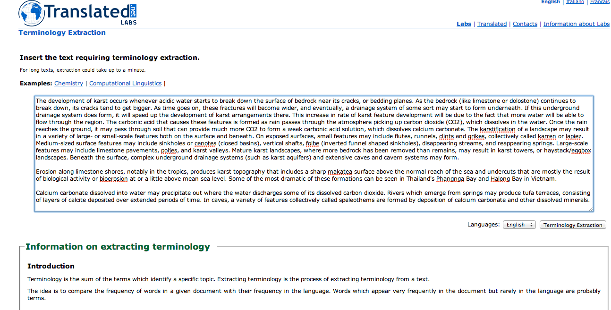
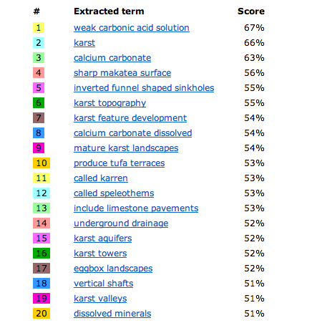
Terminology Symposium Zadar, 22-23 August 2014

Slide 30
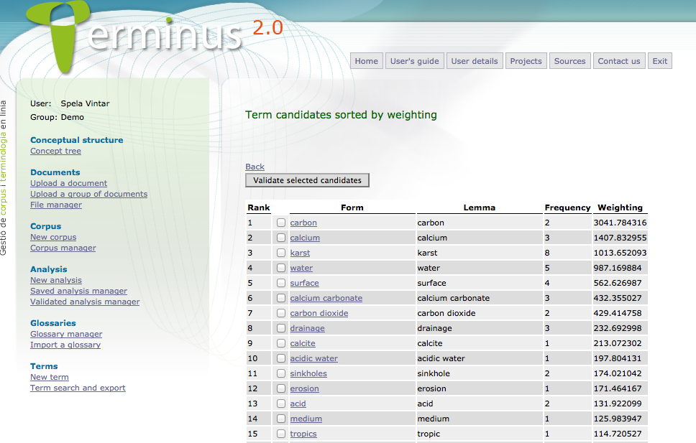
Terminology Symposium Zadar, 22-23 August 2014

Slide 31
Conclusions
Term extraction solutions are available for many languages and seem mature enough to implement in most term management settings
Intended as a technology to support humans, not replace them!
Results depend on several factors:
Language & quality of language tools
Quality, representativity and size of the corpora
User requirements
Domain / Project
Terminology Symposium Zadar, 22-23 August 2014

Slide 32
Conclusions
Definition extraction is at an experimental stage, however...
...Extracting hierarchical relations, synonyms and related terms has a long tradition and works well.
For translation purposes (and some lexicographical tasks), knowledge-rich contexts may be just as valuable.
Even if knowledge extraction tools are not available, state-of-the-art corpus workbenches provide huge support to terminographers.
Terminology Symposium Zadar, 22-23 August 2014

Slide 33
References
Ahrenberg, Lars, Mikael Andersson, and Magnus Merkel. "A simple hybrid aligner for generating lexical correspondences in parallel texts." Proceedings of the 17th international conference on Computational linguistics-Volume 1. Association for Computational Linguistics, 1998.
Bourigault, Didier. Lexter: un Logiciel d'EXtraction de TERminologie: application à l'acquisition des connaissances à partir de textes. Diss. EHESS, 1994.
Dagan, Ido, and Ken Church. "Termight: Identifying and translating technical terminology." Proceedings of the fourth conference on Applied natural language processing. Association for Computational Linguistics, 1994.
Daille, Béatrice. "Study and implementation of combined techniques for automatic extraction of terminology." The balancing act: Combining symbolic and statistical approaches to language 1 (1996): 49-66.
Fišer, Darja, Senja Pollak, and Špela Vintar. "Learning to mine definitions from Slovene structured and unstructured knowledge-rich resources." Proceedings of the 7th Language Resources and Evaluation Conference. 2010.
Frantzi, Katerina, Sophia Ananiadou, and Hideki Mima. "Automatic recognition of multi-word terms:. the c-value/nc-value method." International Journal on Digital Libraries 3.2 (2000): 115-130.
Gaussier, Eric, et al. "A geometric view on bilingual lexicon extraction from comparable corpora." Proceedings of the 42nd Annual Meeting on Association for Computational Linguistics. Association for Computational Linguistics, 2004.
Jacquemin, Christian. Spotting and discovering terms through natural language processing. MIT press, 2001.
Justeson, John S., and Slava M. Katz. "Technical terminology: some linguistic properties and an algorithm for identification in text." Natural language engineering 1.01 (1995): 9-27.
Kilgarriff, Adam, et al. ”The Sketch Engine." Information Technology 105 (2004): 116.
Klavans, Judith L., and Smaranda Muresan. "Evaluation of DEFINDER: a system to mine definitions from consumer-oriented medical text." Proceedings of the 1st ACM/IEEE-CS joint conference on Digital libraries. ACM, 2001.
Mann, Gideon S., and David Yarowsky. "Multipath translation lexicon induction via bridge languages." Proceedings of the second meeting of the North American Chapter of the Association for Computational Linguistics on Language technologies. Association for Computational Linguistics, 2001.

Slide 34
References II
Navigli, Roberto, and Paola Velardi. "Learning word-class lattices for definition and hypernym extraction." Proceedings of the 48th Annual Meeting of the Association for Computational Linguistics. Association for Computational Linguistics, 2010.
Nazar, Rogelio. "A quantitative approach to concept analysis." (2010). Doctoral thesis, UPF.
Nazar, Rogelio. "A statistical approach to term extraction." IJES, International Journal of English Studies 11.2 (2011): 159-182.
Patry, Alexandre, and Philippe Langlais. "Corpus-based terminology extraction." Proceedings of the 7th international conference on terminology and knowledge engineering. 2005.
Sclano, Francesco, and Paola Velardi. "Termextractor: a web application to learn the shared terminology of emergent web communities." Enterprise Interoperability II. Springer London, 2007. 287-290.
Scott, Mike. "PC analysis of key words—and key key words." System 25.2 (1997): 233-245.
Sparck Jones, Karen. "A statistical interpretation of term specificity and its application in retrieval." Journal of documentation 28.1 (1972): 11-21.
Vintar, Špela. "Bilingual term recognition revisited the bag-of-equivalents term alignment approach and its evaluation." Terminology 16.2 (2010): 141-158.
Vivaldi, Jorge, and Horacio Rodríguez. "Evaluation of terms and term extraction systems: A practical approach." Terminology 13.2 (2007): 225-248.
Widdows, Dominic, and Beate Dorow. "A graph model for unsupervised lexical acquisition." Proceedings of the 19th international conference on Computational linguistics-Volume 1. Association for Computational Linguistics, 2002.

Slide 35
Questions & comments welcome!
spela.vintar@ff.uni-lj.si
Terminology Symposium Zadar, 22-23 August 2014

